Slide 1
Christmas Store
Welcome to my Christmas Store!
NEXT PAGE

Slide 2
Recipes for Christmas

Slide 3
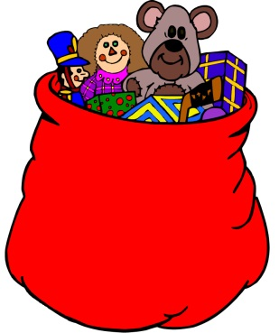



Toys and Decorations!
$8.99
$5.99
$2.99
$5.99

Slide 4
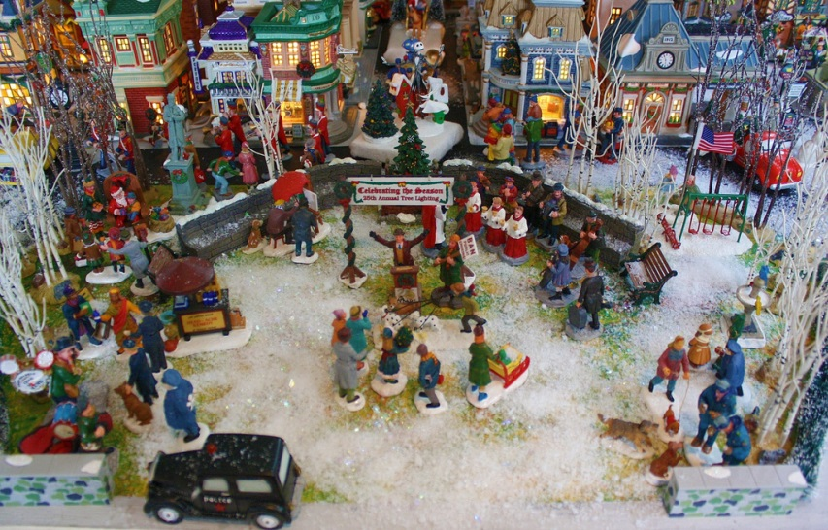
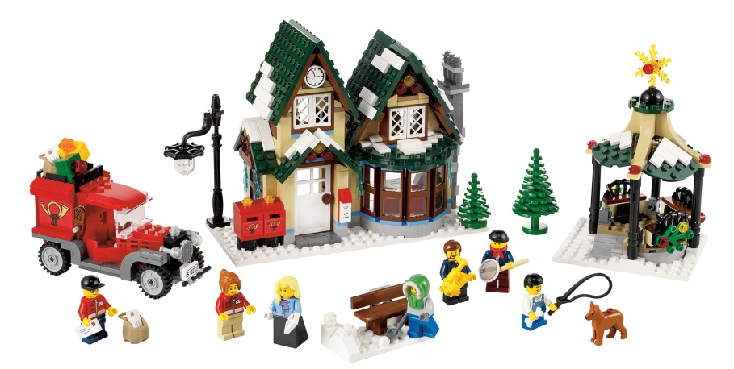
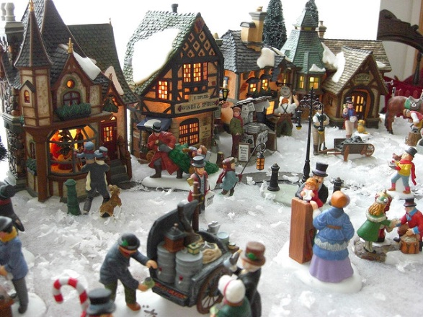
Christmas Villages
Lego set: $29.99
Christmas Night set: $69.99
Christmas Eve Set: $39.99

Slide 5

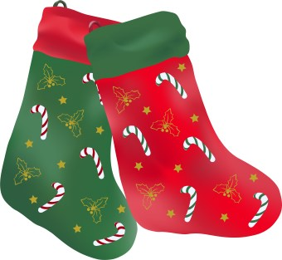
Christmas Stockings
Red or green with candy canes: $10.99
Traditional Red: $8.99

Slide 6
Christmas Hotel
Open year round!
$55.50 a night.
Breakfast, lunch and, dinner are served!
Playground for your children.
Access to store from 8:00 am – 10:00 pm

